Slide 1

Portfolio
safiyaaideed.netlify.app
Safiya aideed
Coder academy flex track, 2020

Slide 2
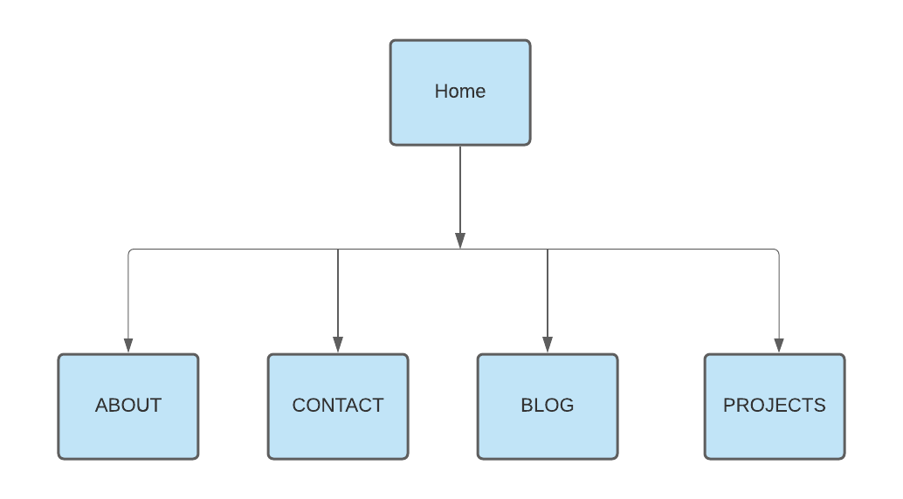
SITEFRAME

Slide 3
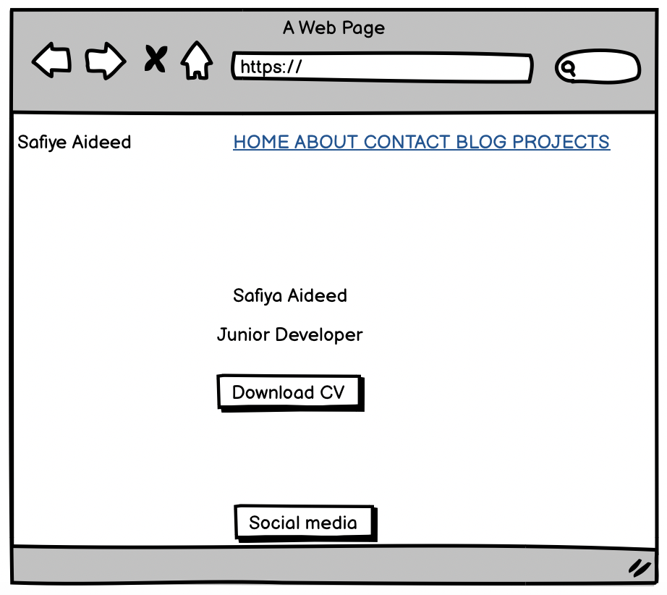
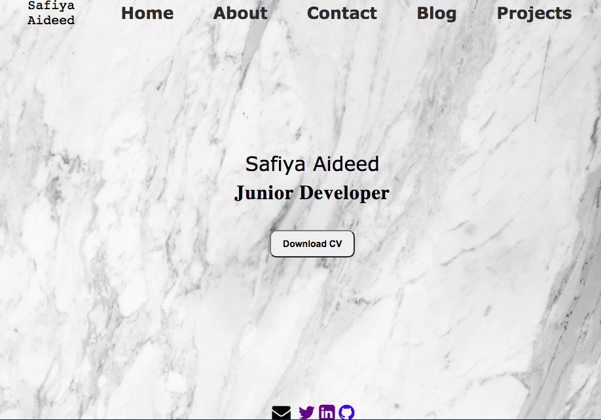
Homepage wireframe

Slide 4
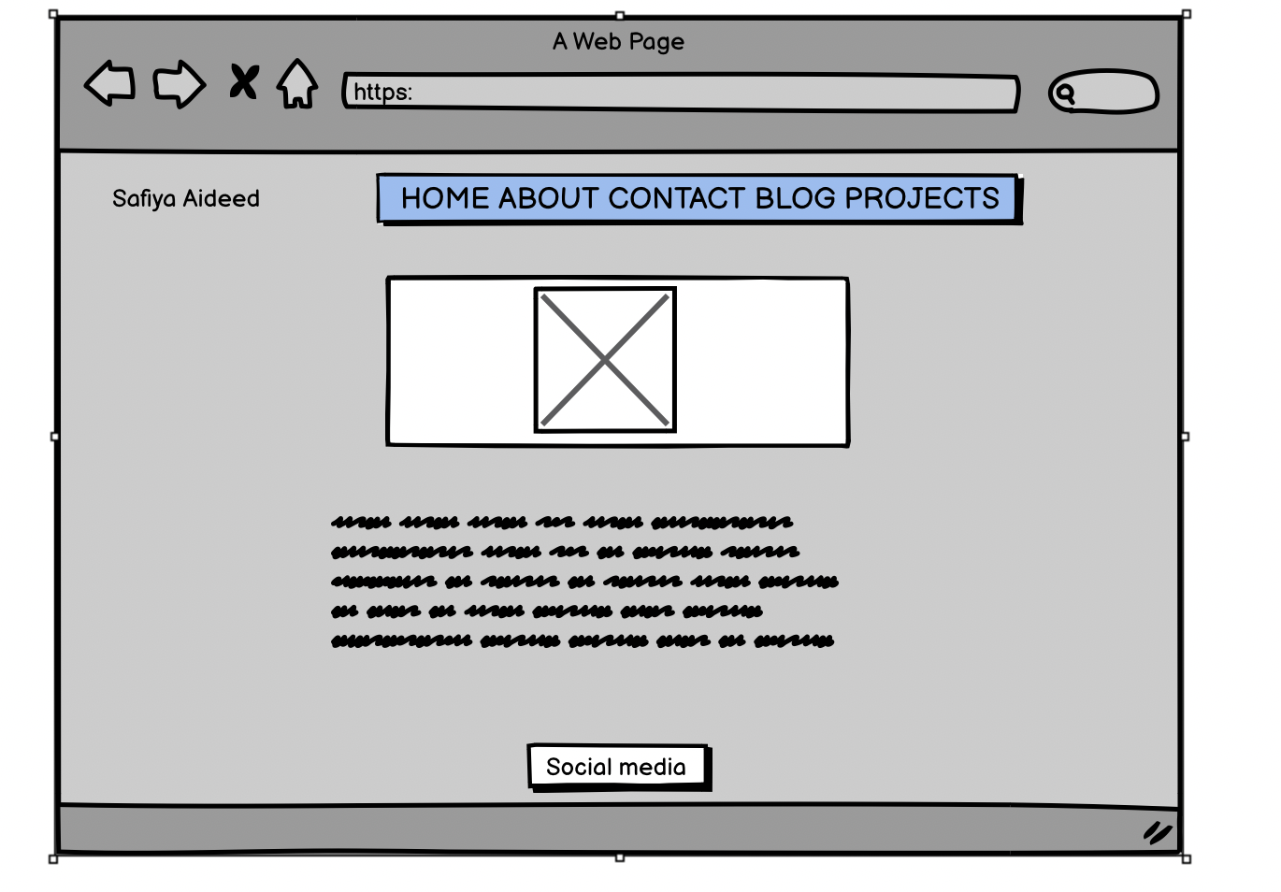
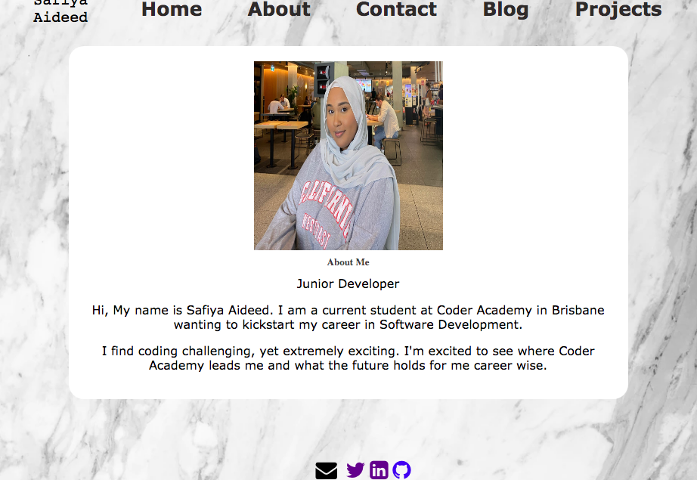
About page wireframe

Slide 5
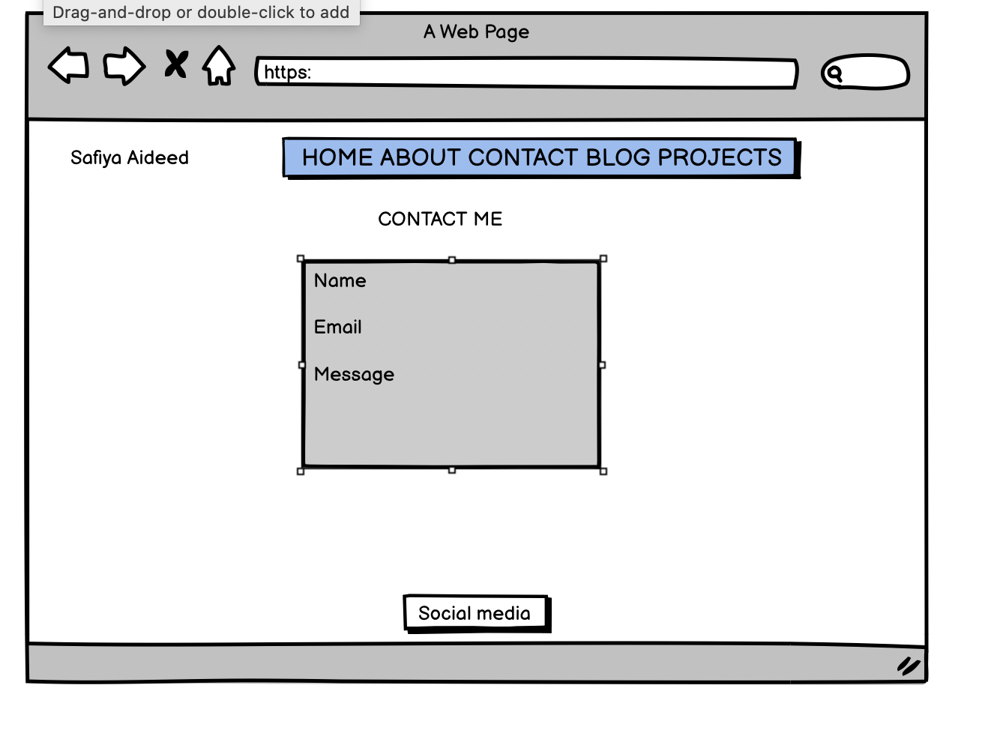
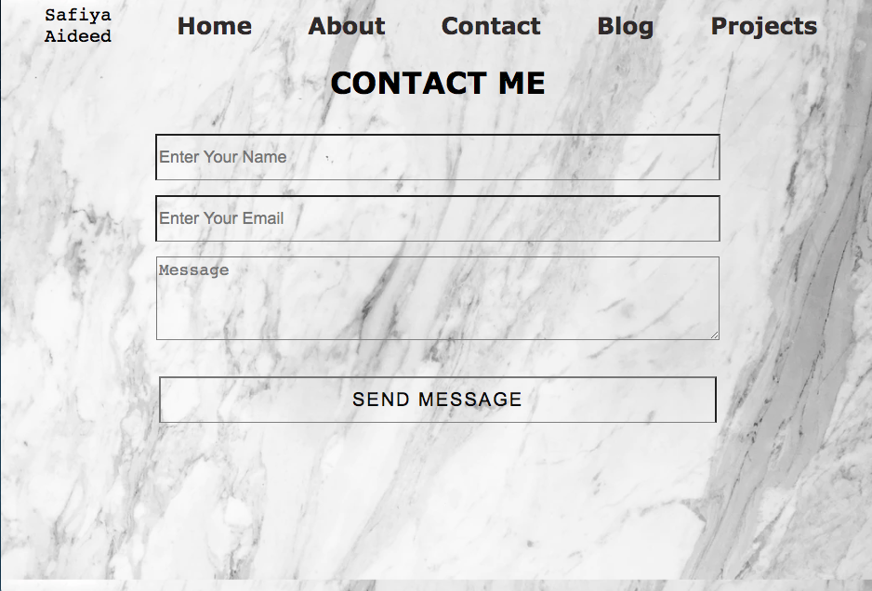
Contact page wireframe

Slide 6
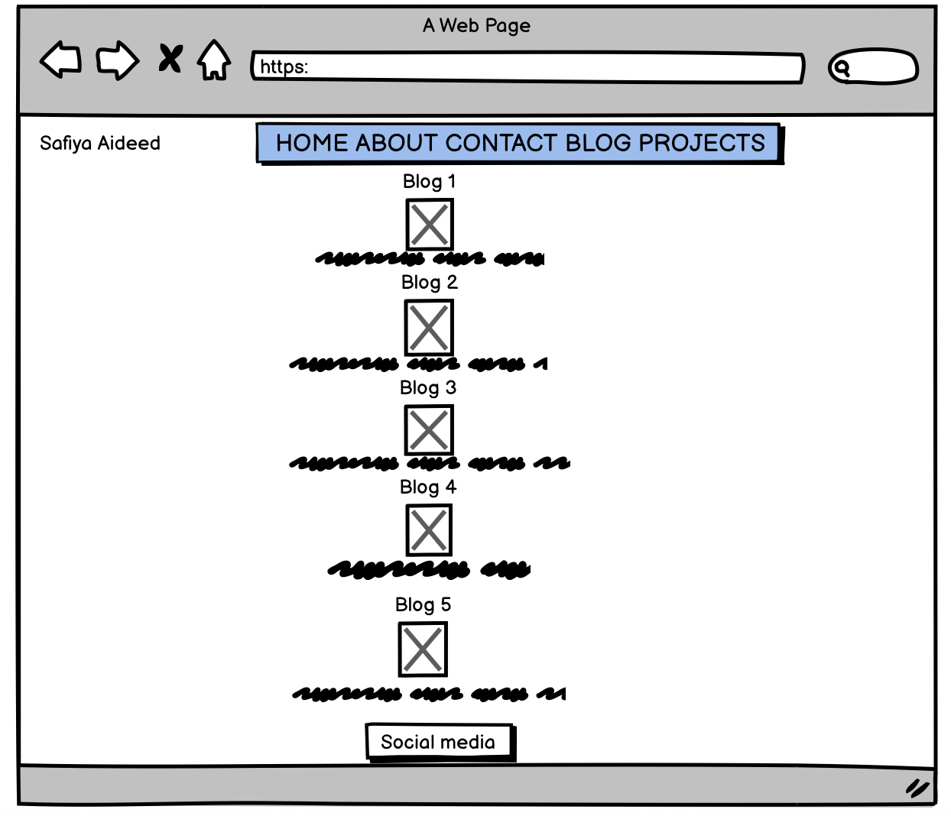
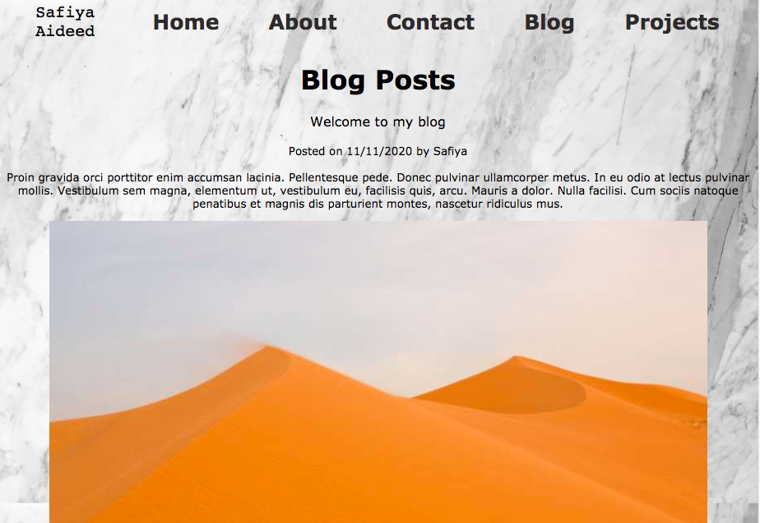
Blog page wire frame

Slide 7
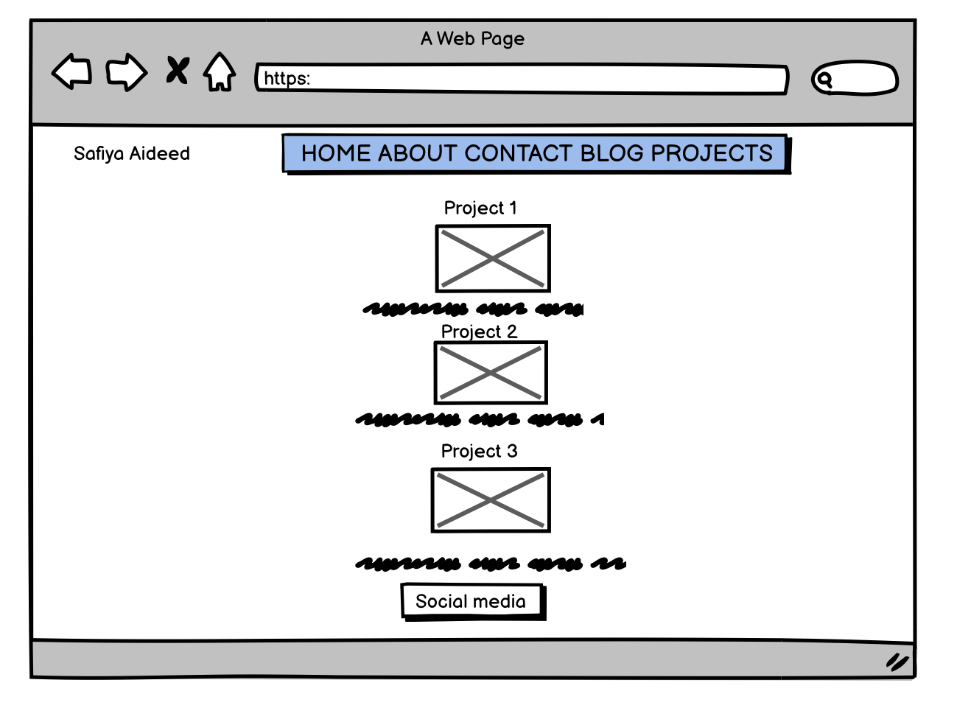
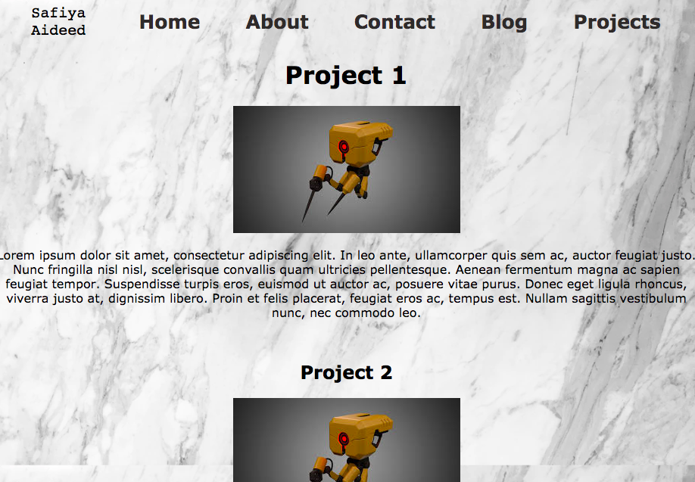
Projects page wireframe

Slide 8
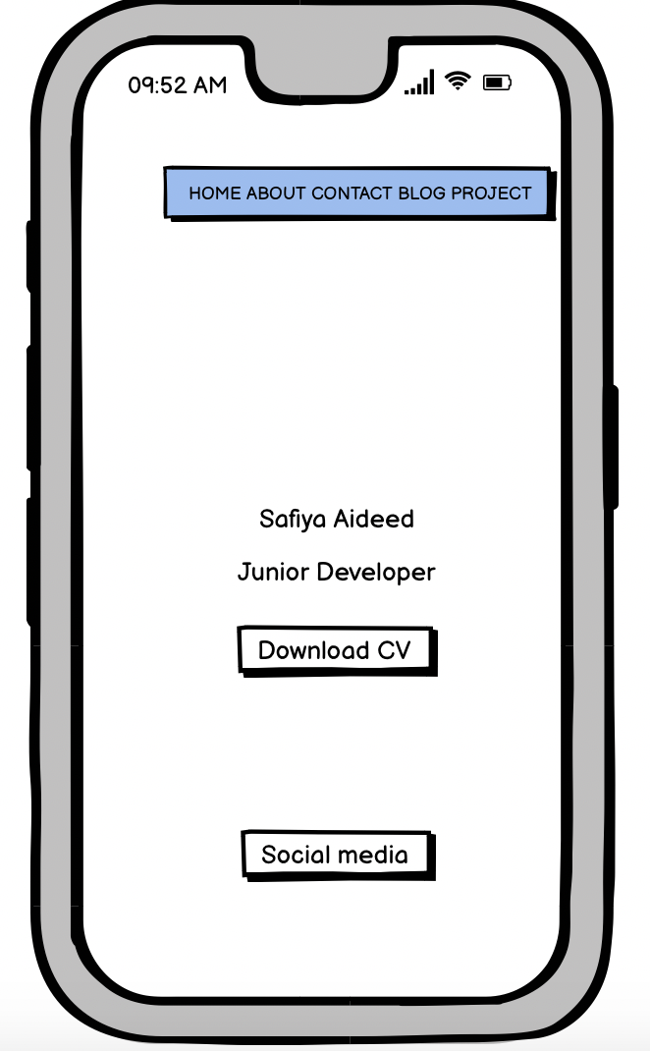
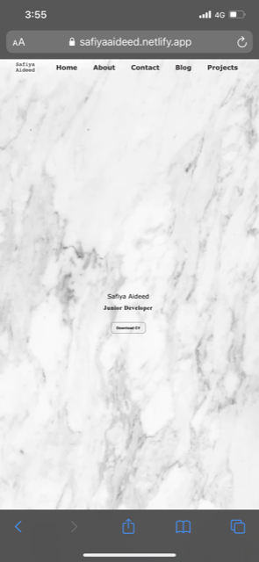
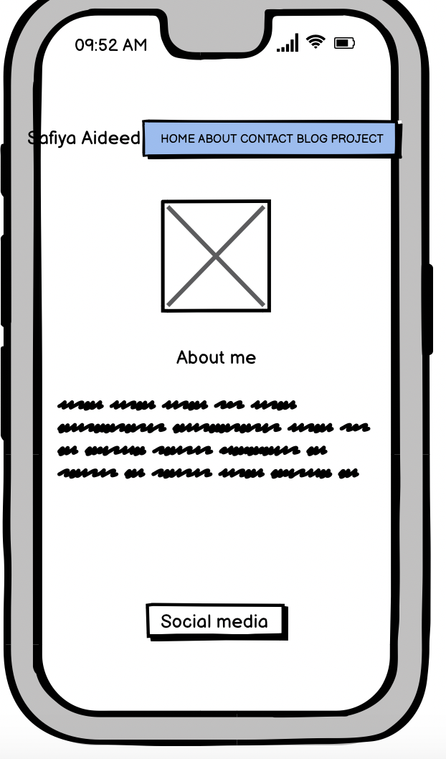
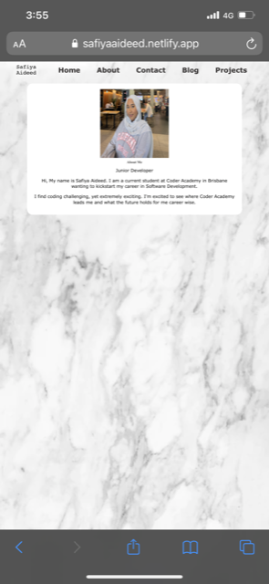
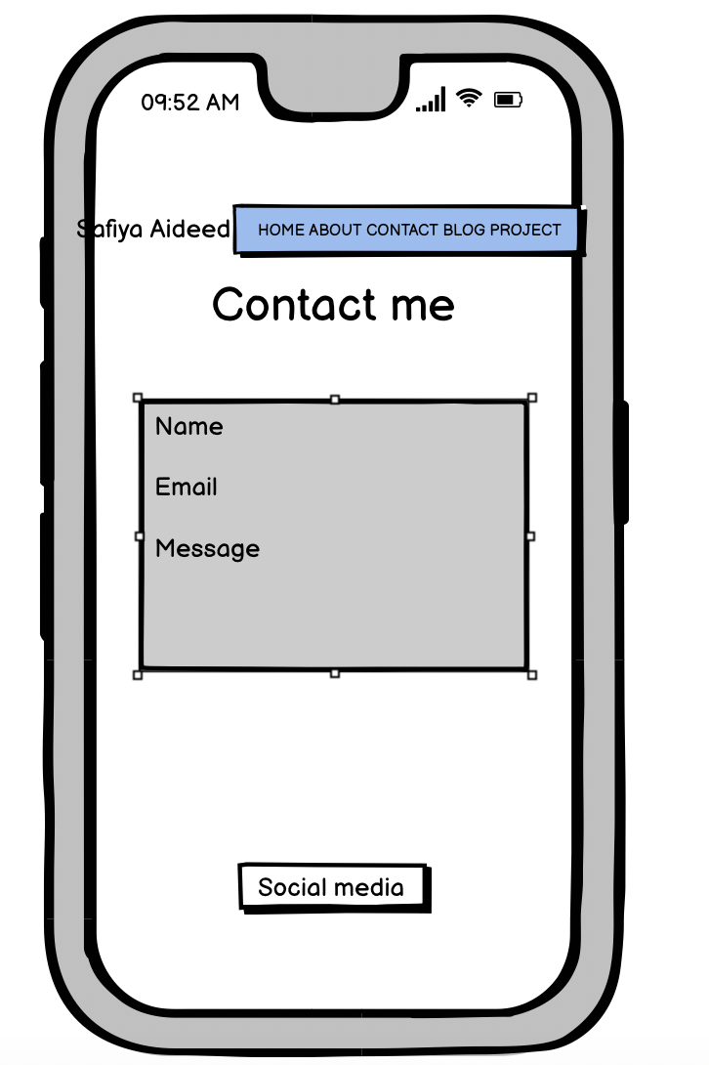
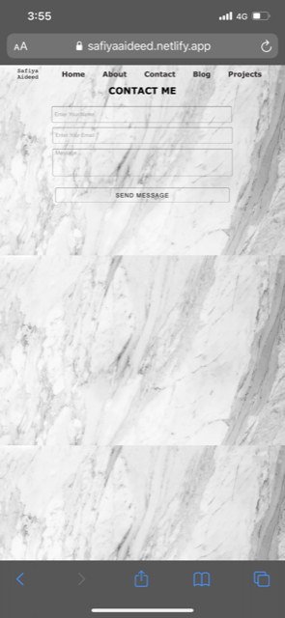
WIREFRAMES FOR MOBILE PHONE
Homepage
About
Contact

Slide 9
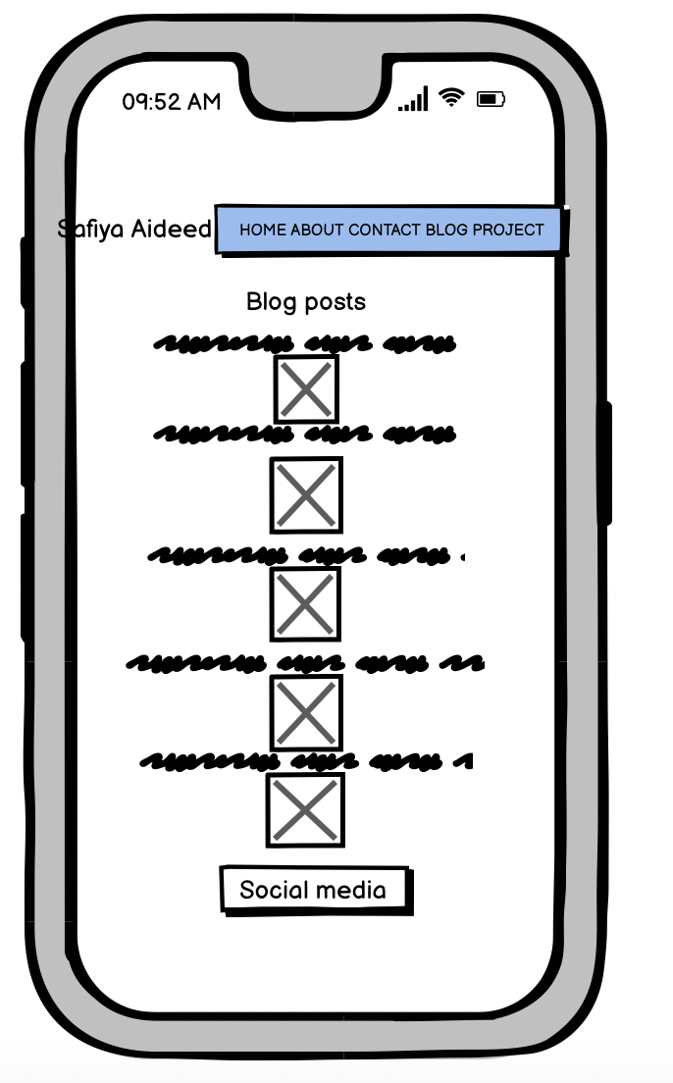
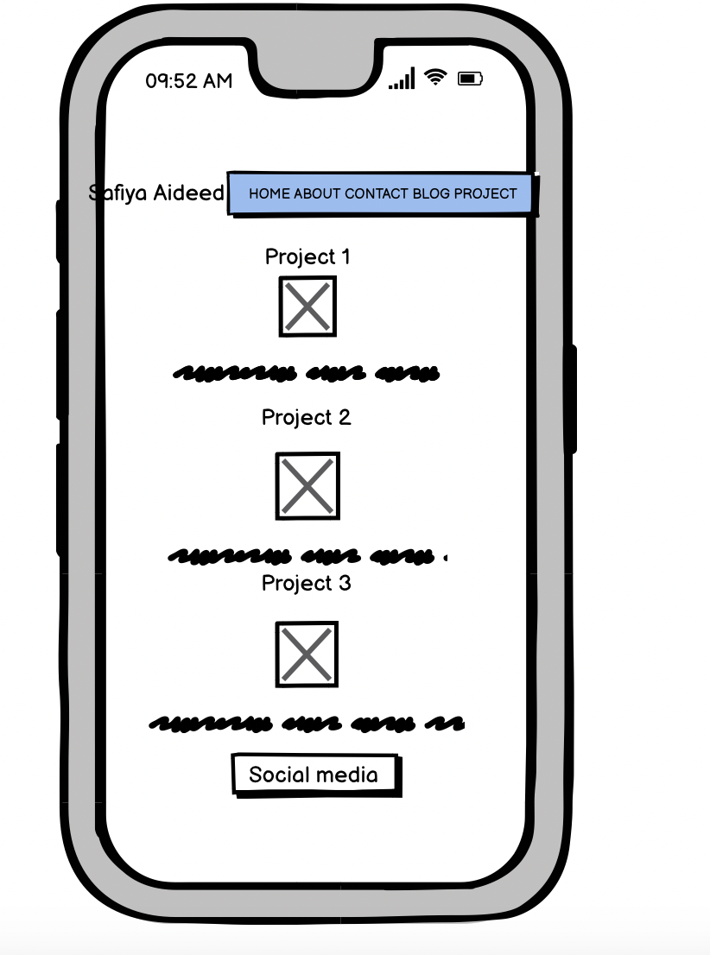
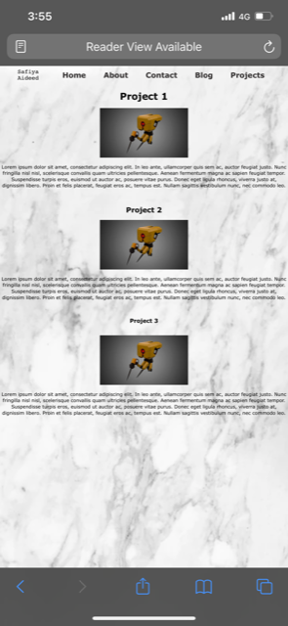
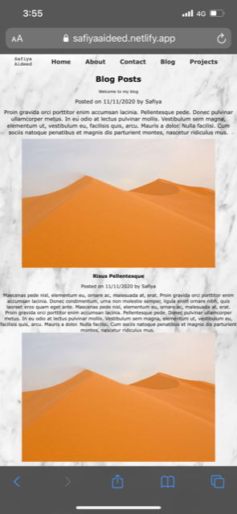
Wireframes for mobile phone
Blog
Projects

Slide 10
Design process and decisions

Slide 11
Challenges!
Issues with social media icons.
Having an issue with a line of code and different websites having different answers.

Slide 12
Ethical issues
Coming across designs or layout that I liked on the internet but having to personalize it.

Slide 13
Favourite parts
First few days of starting the portfolio
Learning how to create a webpage from scratch on my own.
Searching different websites when having issues and always finding the answer.

Slide 14

Thank You
☺

